Slide 1

Excited States and Nonadiabatic Dynamics
CyberTraining School/Workshop 2023
Alexey Akimov
University at Buffalo, SUNY
June 12, 2023

Slide 2
General Workshop Goals
and
Overview of the CyberTraining Infrastructure

Slide 3
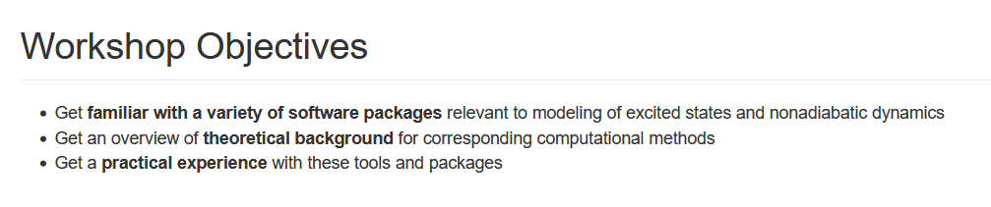

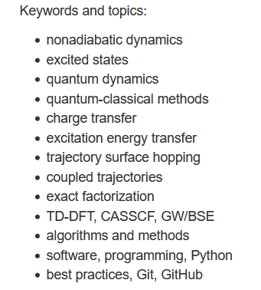
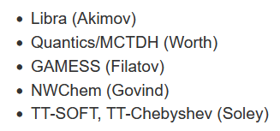
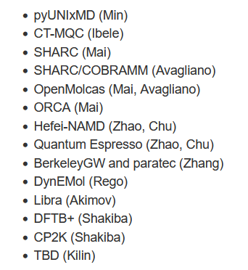
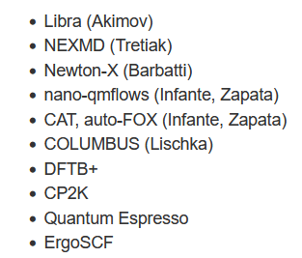
Objectives and Agenda
CyberTraining: Pilot: Modeling Excited State Dynamics in Solar Energy Materials
This year
2022 (in person/virtual)
2021 (virtual)

Slide 4
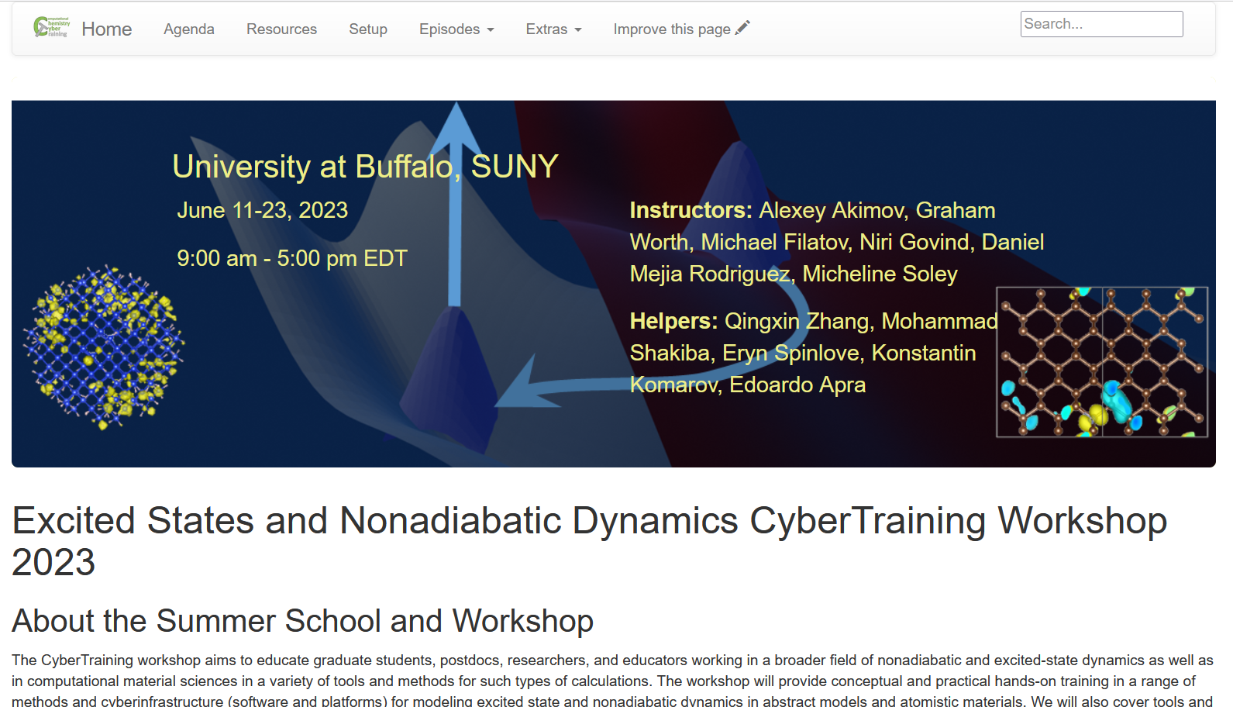
The Plan & Resource
All the details are here:
https://compchem-cybertraining.github.io/Cyber_Training_Workshop_2023
Join Slack:
Members can invite new members
Private and public channels, direct (private) messages, conversations
Any time, no strings attached
https://join.slack.com/t/quantumdynamicshub/shared_invite/zt-mjbhjssx-GGhsbYHxeBMvhmumK_j7LA
VPN and Accounts:
2-factor authentication
submit a ticket: https://ubccr.freshdesk.com/support/home

Slide 5
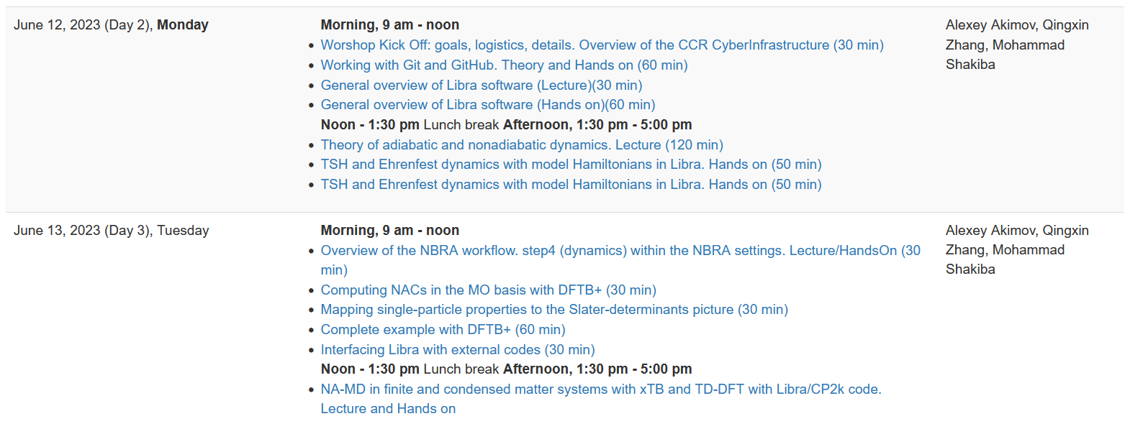

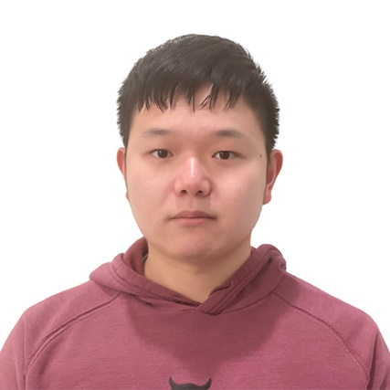
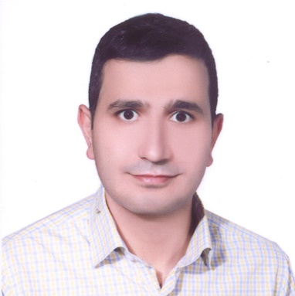
Topics and Instructors
Libra
https://github.com/Quantum-Dynamics-Hub/libra-code
https://compchem-cybertraining.github.io/Cyber_Training_Workshop_2023/_episo des/03-libra
https://github.com/compchem-cybertraining/Tutorials_Libra
https://github.com/compchem-cybertraining/Tutorials_DFTB_plus
Mohammad Shakiba
https://github.com/compchem-cybertraining/Tutorials_CP2K
Alexey Akimov
Qingxin Zhang

Slide 6
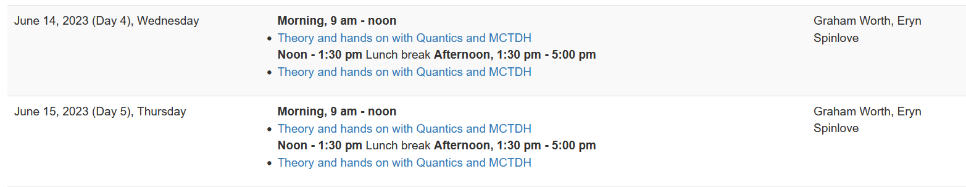

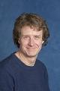
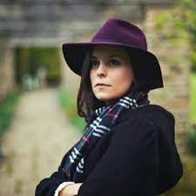
Topics and Instructors
Quantics
http://www2.chem.ucl.ac.uk/quantics/
https://compchem-cybertraining.github.io/Cyber_Training_Workshop_2023/_episodes/04-quantics
https://github.com/compchem-cybertraining/Tutorials_Quantics
Graham Worth
Eryn Spinlove

Slide 7
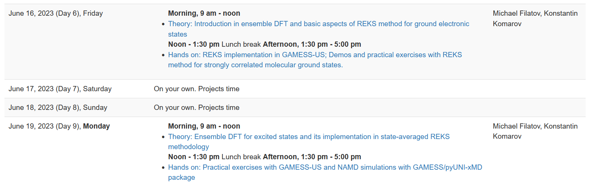
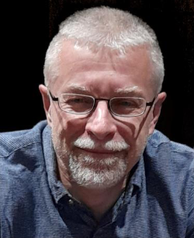
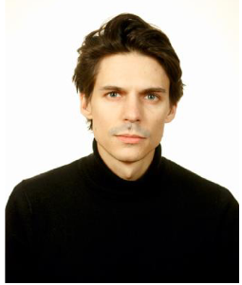
Topics and Instructors
GAMESS US
https://www.msg.chem.iastate.edu/gamess/
https://compchem-cybertraining.github.io/Cyber_Training_Workshop_2023/_episodes/05-gamess
https://github.com/compchem-cybertraining/Tutorials_GAMESS
Konstantin Komarov
(remotely)
Michael Filatov (Gulak)

Slide 8
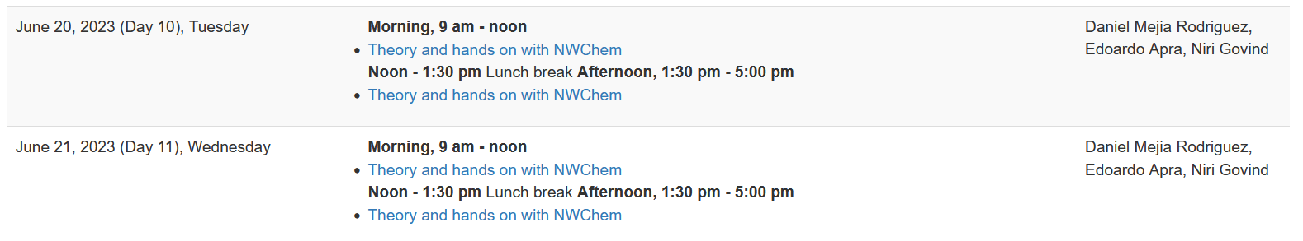
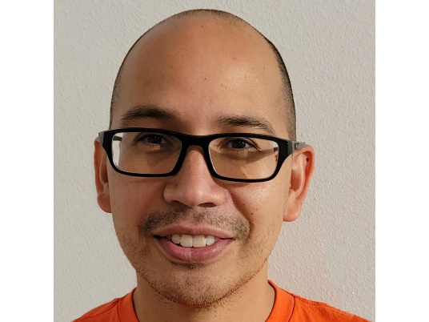
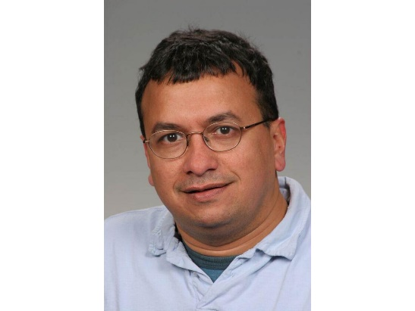
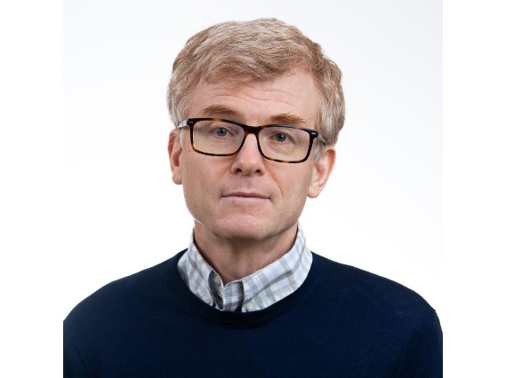
Topics and Instructors
NWChem
https://nwchemgit.github.io
Daniel Mejia-Rodriguez
Niri Govind (remotely)
Edoardo Apra (remotely)
https://compchem-cybertraining.github.io/Cyber_Training_Workshop_2023/_episodes/06-nwchem
https://github.com/compchem-cybertraining/Tutorials_NWChem

Slide 9
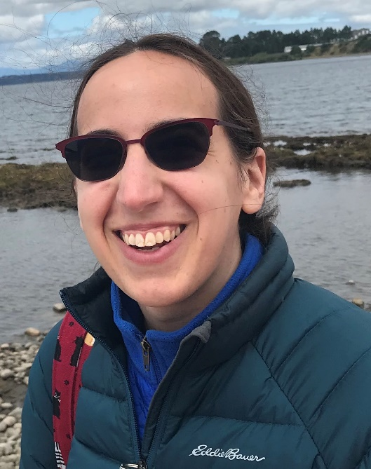
Topics and Instructors
TT-SOFT and TT-Chebyshev
https://compchem-cybertraining.github.io/Cyber_Training_Workshop_2023/_episodes/07-ttsoft
https://github.com/compchem-cybertraining/Tutorials_NWChem
Micheline Soley

Slide 10
Please Introduce Yourself
Name, position, affiliation, research group
Research interests and expertise
Anything else you would like to share with us

Slide 11
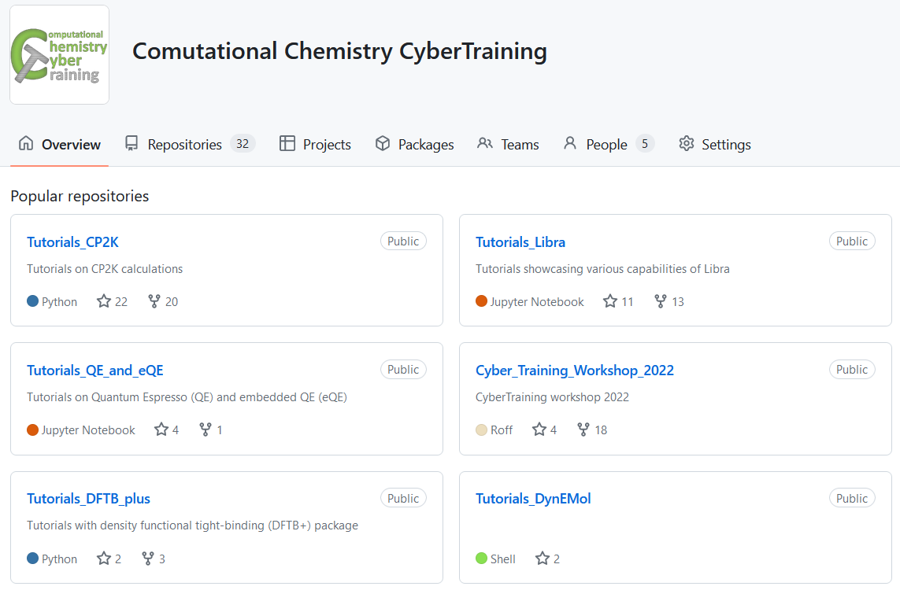
More Resources
Codes: https://github.com/Quantum-Dynamics-Hub
Training: https://github.com/compchem-cybertraining
Quantum Dynamics Hub: https://quantum-dynamics-hub.github.io/
Summer 2021 workshop: https://compchem-cybertraining.github.io/Cyber_Training_Workshop_2021/
Libra Winter school: https://compchem-cybertraining.github.io/Libra_Winter_School_2022/
Summer 2022 workshop: https://compchem-cybertraining.github.io/Cyber_Training_Workshop_2022/
Summer 2023 (This!) workshop: https://compchem-cybertraining.github.io/Cyber_Training_Workshop_2023/

Slide 12
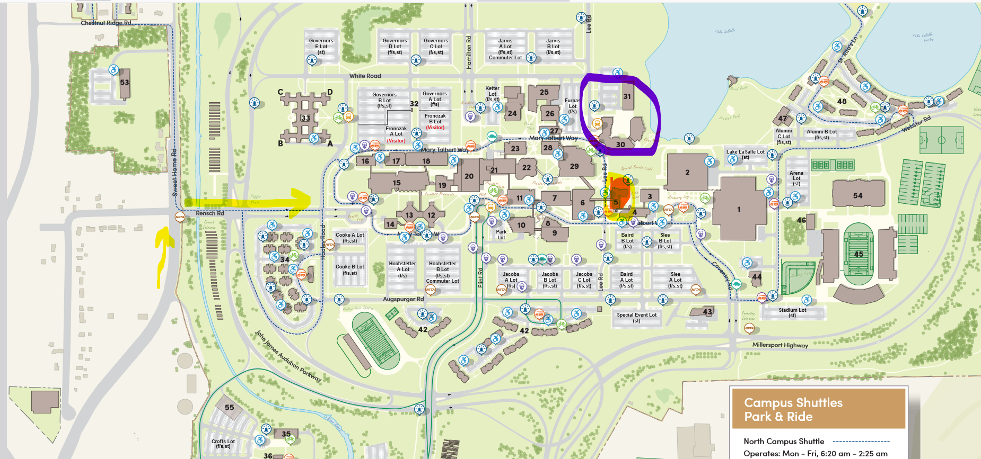
Daily Schedule
Daily
Breakfast = hotel
9:00 am – 12:00 pm: Morning session (Recording)
12:00 – 1:30 pm Working lunch/rest – on your own at “Commons”, rest, discuss, collaborate
1:30 pm – 5:00 pm: Afternoon session (Recording)
After 5:00 pm: collaborations/on your own, dinner on your own
Location
Classes are @: June 12 – 22 Clemens 120
Lunch
Campus Map: https://emergency.buffalo.edu/content/dam/www/parking/North%20Campus%20Parking%20Map%2011x17.pdfhttps://emergency.buffalo.edu/content/dam/www/parking/North%20Campus%20Parking%20Map%2011x17.pdf
Classes
Your Hotels

Slide 13
Logistic
We cover your hotel stay (except for the local folks). Stipends also cover the rest of expenses, please keep your receipts just in case. Let me know your flight expenses via the Google form provided on Slack channel.
Travel for the US participants to a reasonable amount, partially the international participants (as the funds allow), except for local/UB-affiliated folks.
Paperwork: All trainees will need to fill in the RF Participation Stipend form and one of the other two forms: W-9 - for the US residents and W-8BEN for the non-residents. The forms are distributed to you via Slack – please DON’t sent them back via e-mail – upload to the form provided or via Slack.
A lot of paperwork later – likely it’ll be just me handling most of the stuff
Prizes: $300 (1 first prize), $200 (3 second prizes), $100 (5 first prizes) – the project competition. Online and in-person participants are eligible. UB-affiliated participants are eligible too.
Reimbursement/honoraria to the instructors – a separate paperwork. Will send you instructions via the Instructors Channel on Slack.

Slide 14
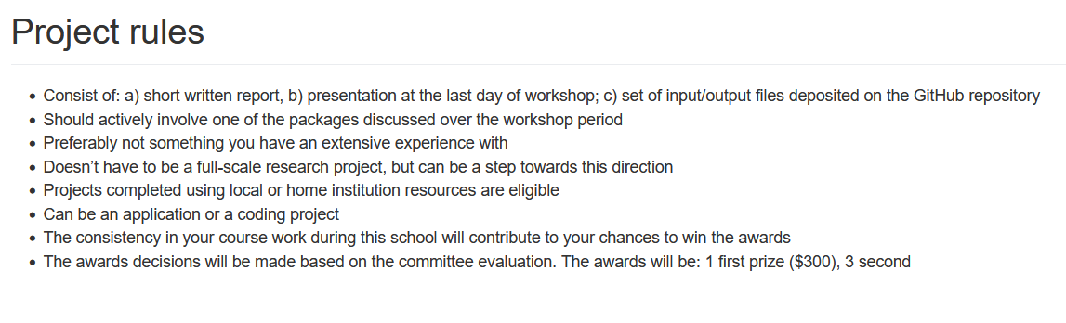
Course Project
https://compchem-cybertraining.github.io/Cyber_Training_Workshop_2023/CODE_OF_CONDUCT.html
Submit your project via GitHub by June 30
Oral presentation – tentatively July 1-2, via Zoom
Check out the past years’ projects:
https://github.com/compchem-cybertraining/Cyber_Training_Workshop_2021/tree/gh-pages/course_work
https://compchem-cybertraining.github.io/Cyber_Training_Workshop_2021/_episodes/13-projects
https://github.com/compchem-cybertraining/Cyber_Training_Workshop_2022/tree/gh-pages/course_work
https://compchem-cybertraining.github.io/Cyber_Training_Workshop_2022/_episodes/15-projects

Slide 15
Getting Started on UB CCR

Slide 16
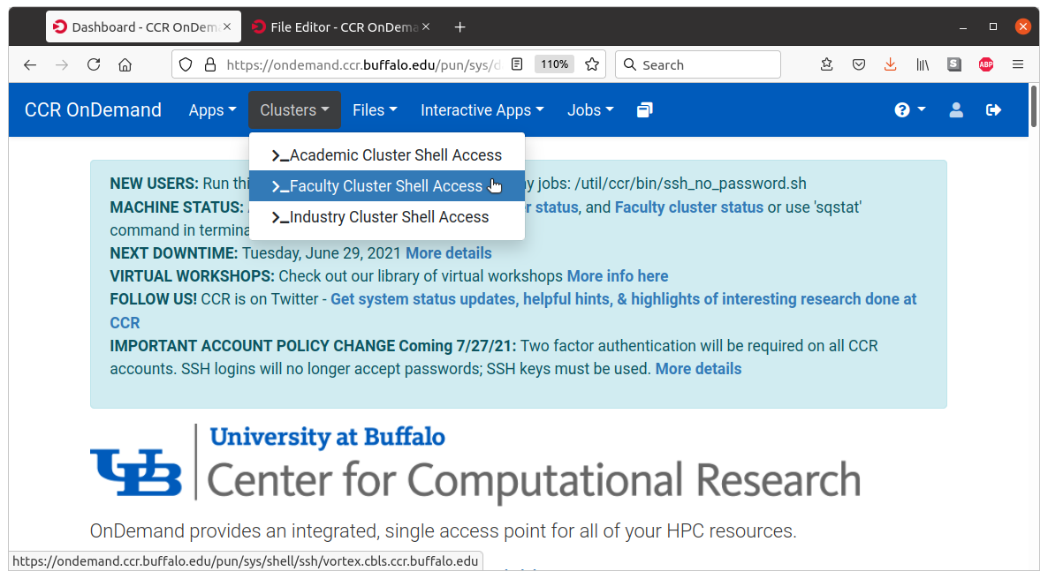
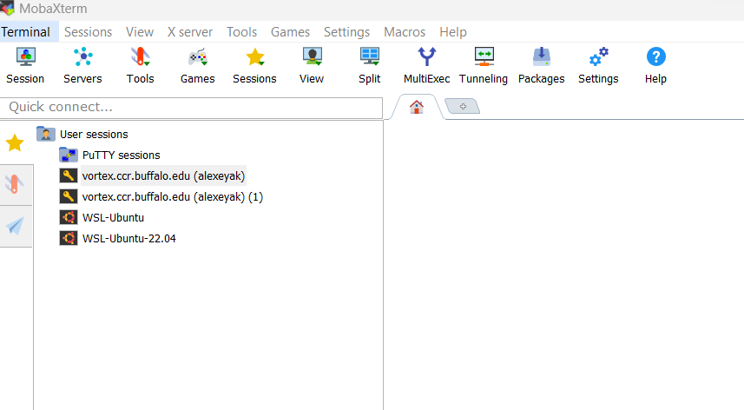
Accessing UB Computing Resources
Before the Workshop
https://compchem-cybertraining.github.io/Cyber_Training_Workshop_2023/setup.html
https://compchem-cybertraining.github.io/Cyber_Training_Workshop_2023/_episodes/01-introduction
OnDemand (not Firefox, use Chrome)
On campus – nothing special;
Off-campus – use UB VPN
https://ondemand.ccr.buffalo.edu/
Moba Xterm
Generate the SSH public/private key.
Use Moba Tools -> MobaKeyGen
Coordinate it with your UB credentials
https://docs.ccr.buffalo.edu/en/latest/portals/idm/

Slide 17
Accessing UB Computing Resources
Your .bashrc file (in your home directory)
# .bashrc
# User specific aliases and functions
# Source global definitions
if [ -f /etc/bashrc ]; then
. /etc/bashrc
fi
module use /projects/academic/cyberwksp21/Modules
eval "$(/projects/academic/cyberwksp21/SOFTWARE/Conda/bin/conda shell.bash hook)"
Restart terminal or `source .bashrc`
For terminal-based operations: Activate conda environment: `conda activate libra2`
For Jupyter – just launch it
Projects directory: /projects/academic/cyberwksp21 - slower, smaller, but permanent
Scratch space: /panasas/scratch/grp-cyberwksp21 - faster, larger, but temporarily (unused files are cleaned up every 1 or 2 weeks)

Slide 18
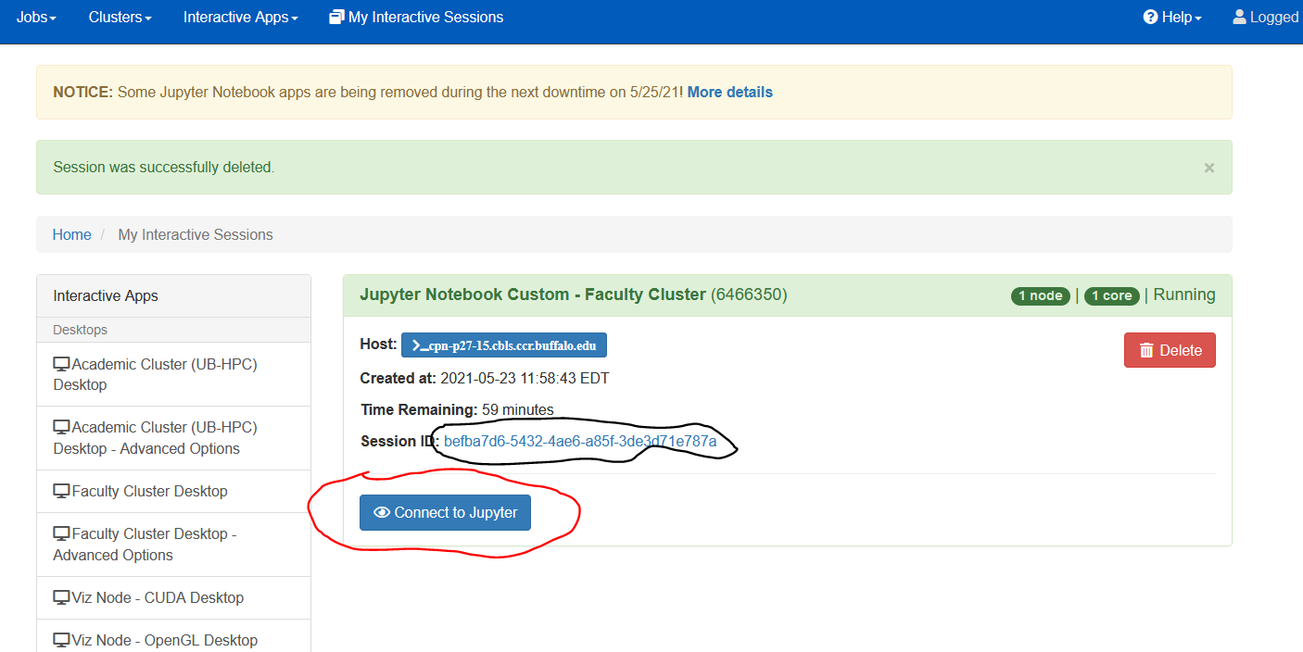
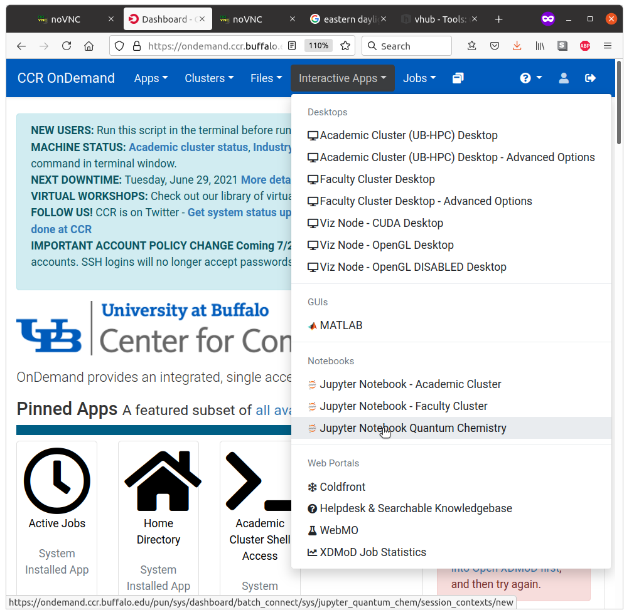
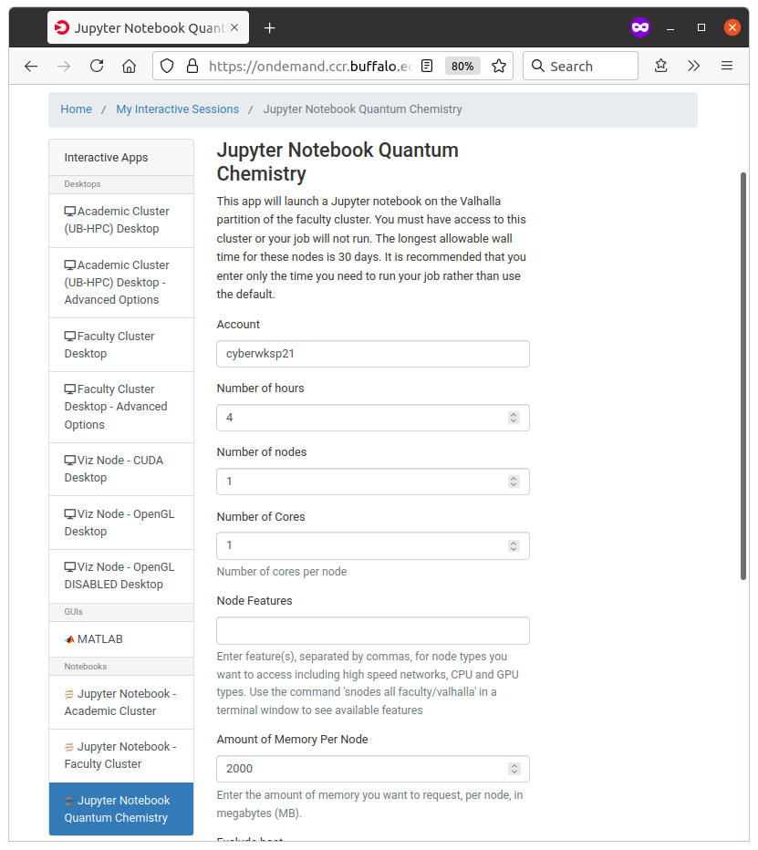
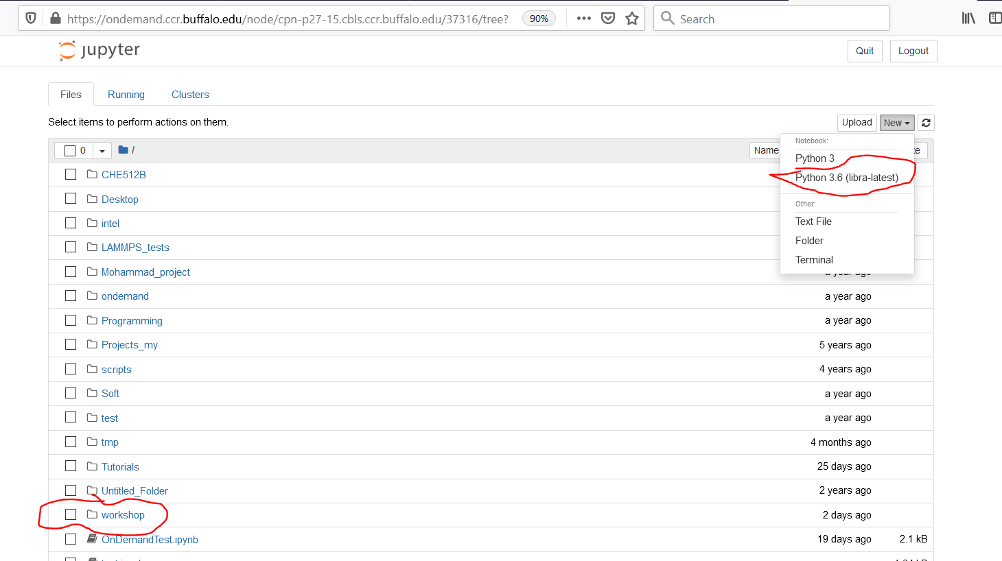
Using Jupyter Notebooks
https://compchem-cybertraining.github.io/Cyber_Training_Workshop_2023/_episodes/01-introduction

